Slide 1
SAP BTP Extension Suite Training
Day 14
Anubhav Oberoy
www.AnubhavTrainings.com
Follow excellence with sheer passion

Slide 2


DISCLAIMER
The training content and delivery of this presentation is confidential, and cannot be recorded, or copied and distributed to any third party, without the written consent of Anubhav Trainings

Slide 3
Agenda – Day 14
01
Build Workzone
02
Clean Core
03
Use cases for Clean Core

Slide 4
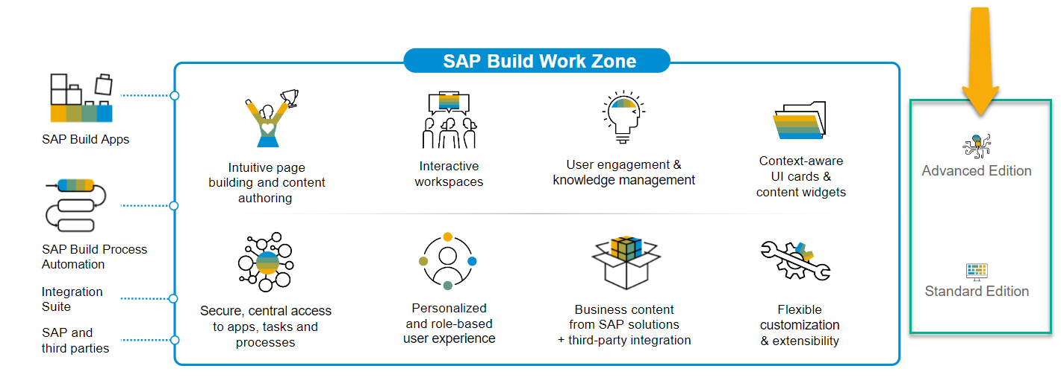
SAP Build Work Zone?
SAP Build Work Zone, advanced edition is a powerful SAP Business Technology Platform service that consists of several components
SAP Launchpad Services is now called SAP Build Work Zone, Standard SAP Work Zone is now called SAP Build Work Zone, Advanced

Slide 5























































Slide 6



































Slide 7

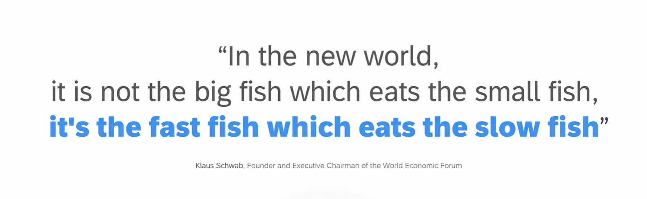
11
www.anubhavtrainings.com

Slide 8
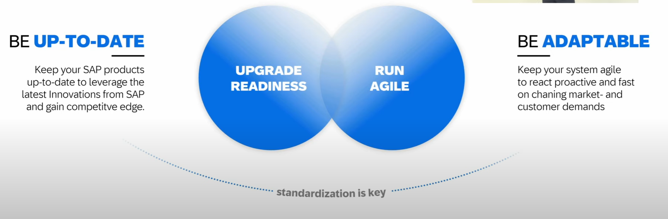
How to be Fast
11
www.anubhavtrainings.com

Slide 9
Clean Core
Clean means up-to-date, documented, unmodified, consistent, efficient and upgrade ready.
S/4HANA Cloud Private Edition => S/4HANA On-premise – GUI Access, Full Control on system, upgrade when customer want, postpone upgrades, SPRO Access, Full access to system code like ECC – 85-90%
S/4HANA Cloud Public Edition => Shared environment, Infra is owned by SAP, not have full control and code, No SAPGUI access, only through browser, Force upgrade (always up to date) -10~15%
Capabilities of clean core depend on Software stack.
Bundle for Rise/Grow with SAP – ERP (Core S/4HANA), BTP (BTPEA), SAC, DS…
11
www.anubhavtrainings.com

Slide 10
Benefits
Access to Innovation – all the latest S/4HANA features can be accessed faster because since you don’t have dependency on custom code, you can upgrade in short time, agile to decide. SAP partners can offer upgrade at fix price.
Upgrade Simplicity – You can apply upgrades stress free.
Lower TCO – Since we follow clean core, we actually use upgrade safe APIs to develop our custom apps. This remains stable release-on-release.
Enhanced security – secure your data and applications which are exposed in cloud.
Improved performance – core is clean, it doesn’t have to interact with lots of custom code, store custom code hence increase the speed.
Data Simplification – which data is privates, which data is public.
11
www.anubhavtrainings.com

Slide 11
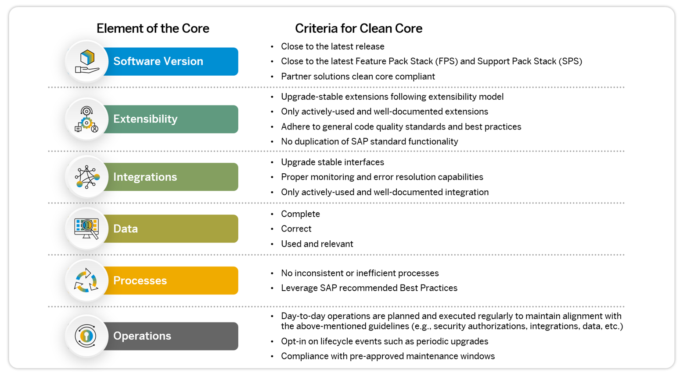
Elements of Clean Core
11
www.anubhavtrainings.com

Slide 12
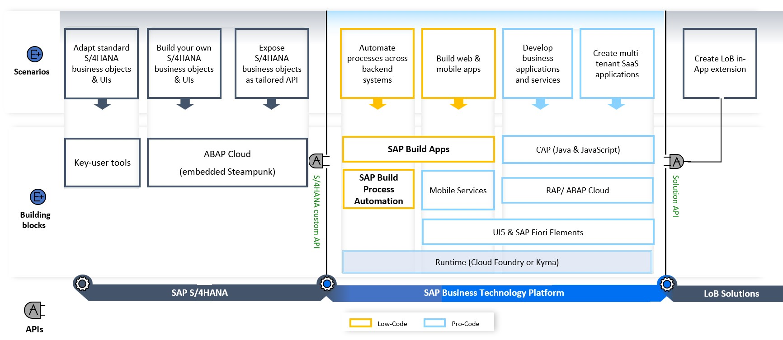
High Level Guidence
<content>
https://youtu.be/n0oS1eiOWU0
11
www.anubhavtrainings.com

Slide 13
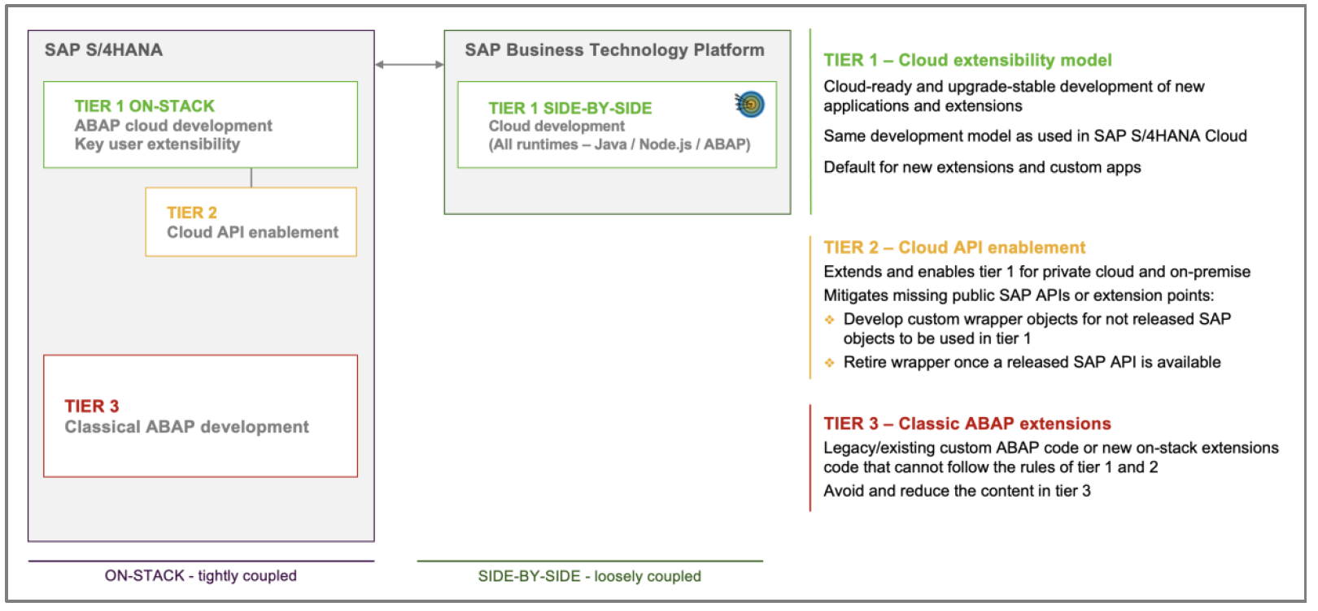
SAP Extensibility Model – Tier 1,2,3
11
www.anubhavtrainings.com

Slide 14
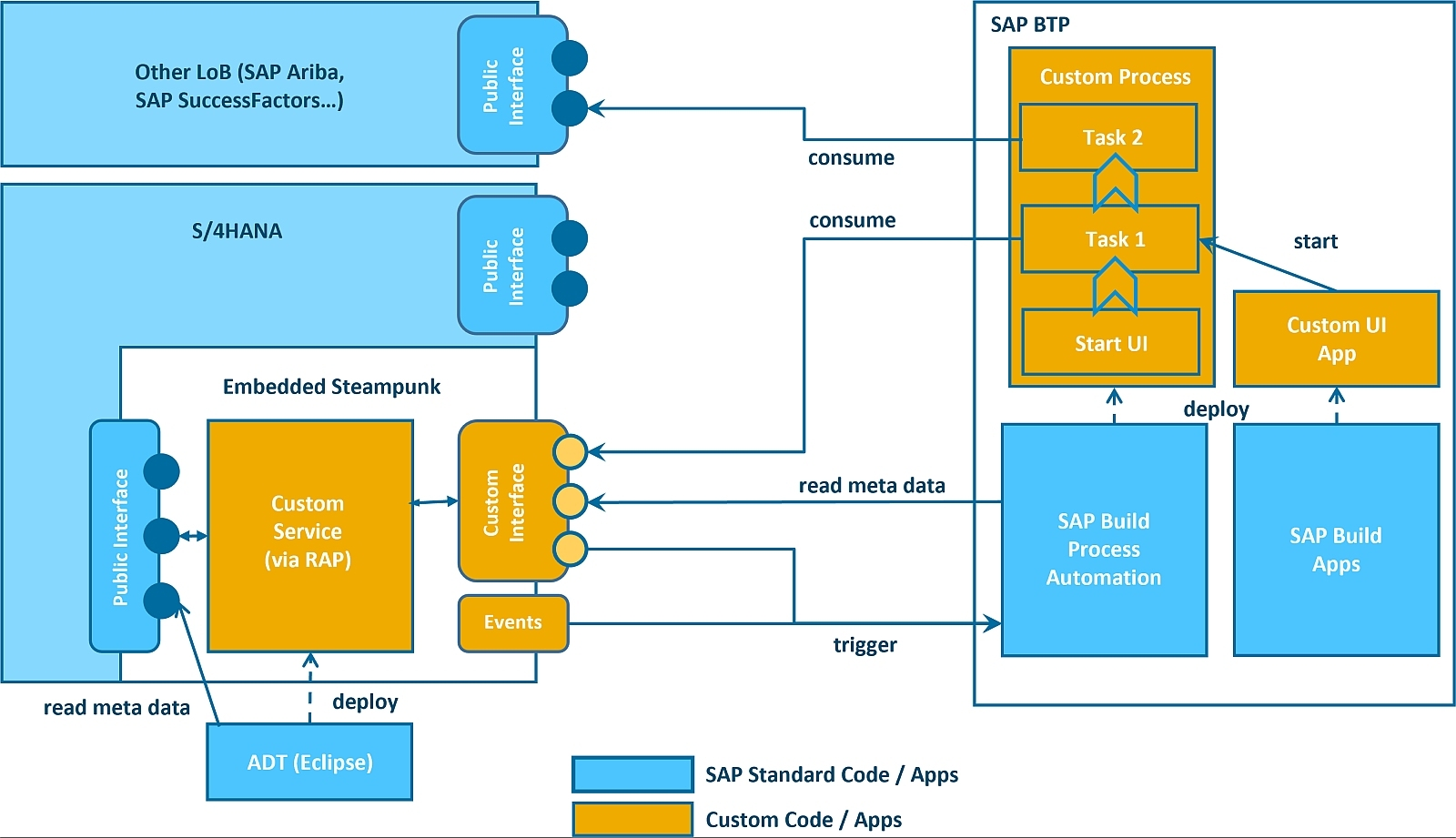
Detailed Journey
11
www.anubhavtrainings.com

Slide 15

What We Did
Let’s Summarize

Slide 16

www.anubhavtrainings.com
Thank You
End of Day 14

Slide 17


We’re committed to empower you to be
#FutureReady
through powerful training solutions.
We build the workforce of the future.
260+
Corporate Clients
60,000+
Learners Trained
26000+
Learners Placed
FREE WEBINARS
Sign up for free webinars with industry experts every fortnight!
Enroll Now!
Contact us today!
https://anubhavtrainings.com

